Slide 1


Marketing Management
Created A Marketing Plan To Introduce Lookover (A Wrist Band)
Kriti Chhabra

Slide 2

3960 fatal accidents/year due to drowning, 8080 non-fatal but severe drowning cases in the United States.
Texas is No.2 in child death rate in The United States.
500 kids die from house fire.
100 kids die due to falling from stairs.

Slide 3
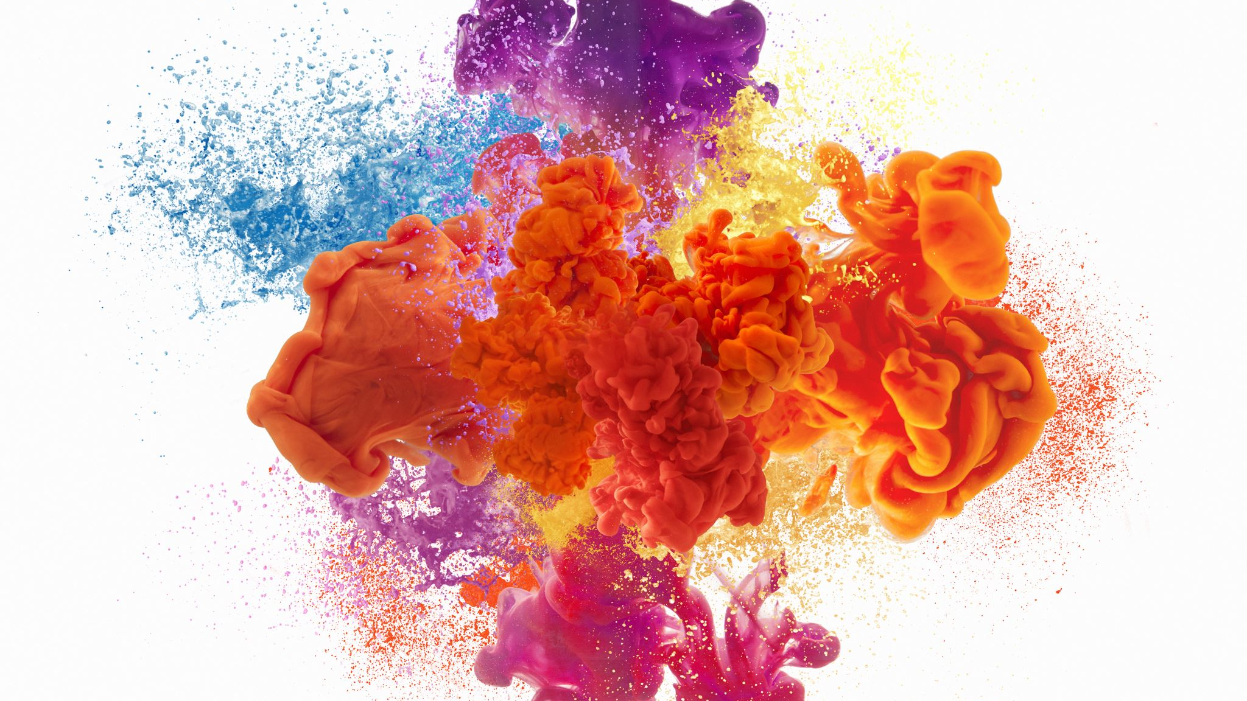
Look-Over

Slide 4

About the company:
Startup with GERBER as our early investor.
Manufacturing in China.
Patent for our product.
Budget: $10 Million

Slide 5

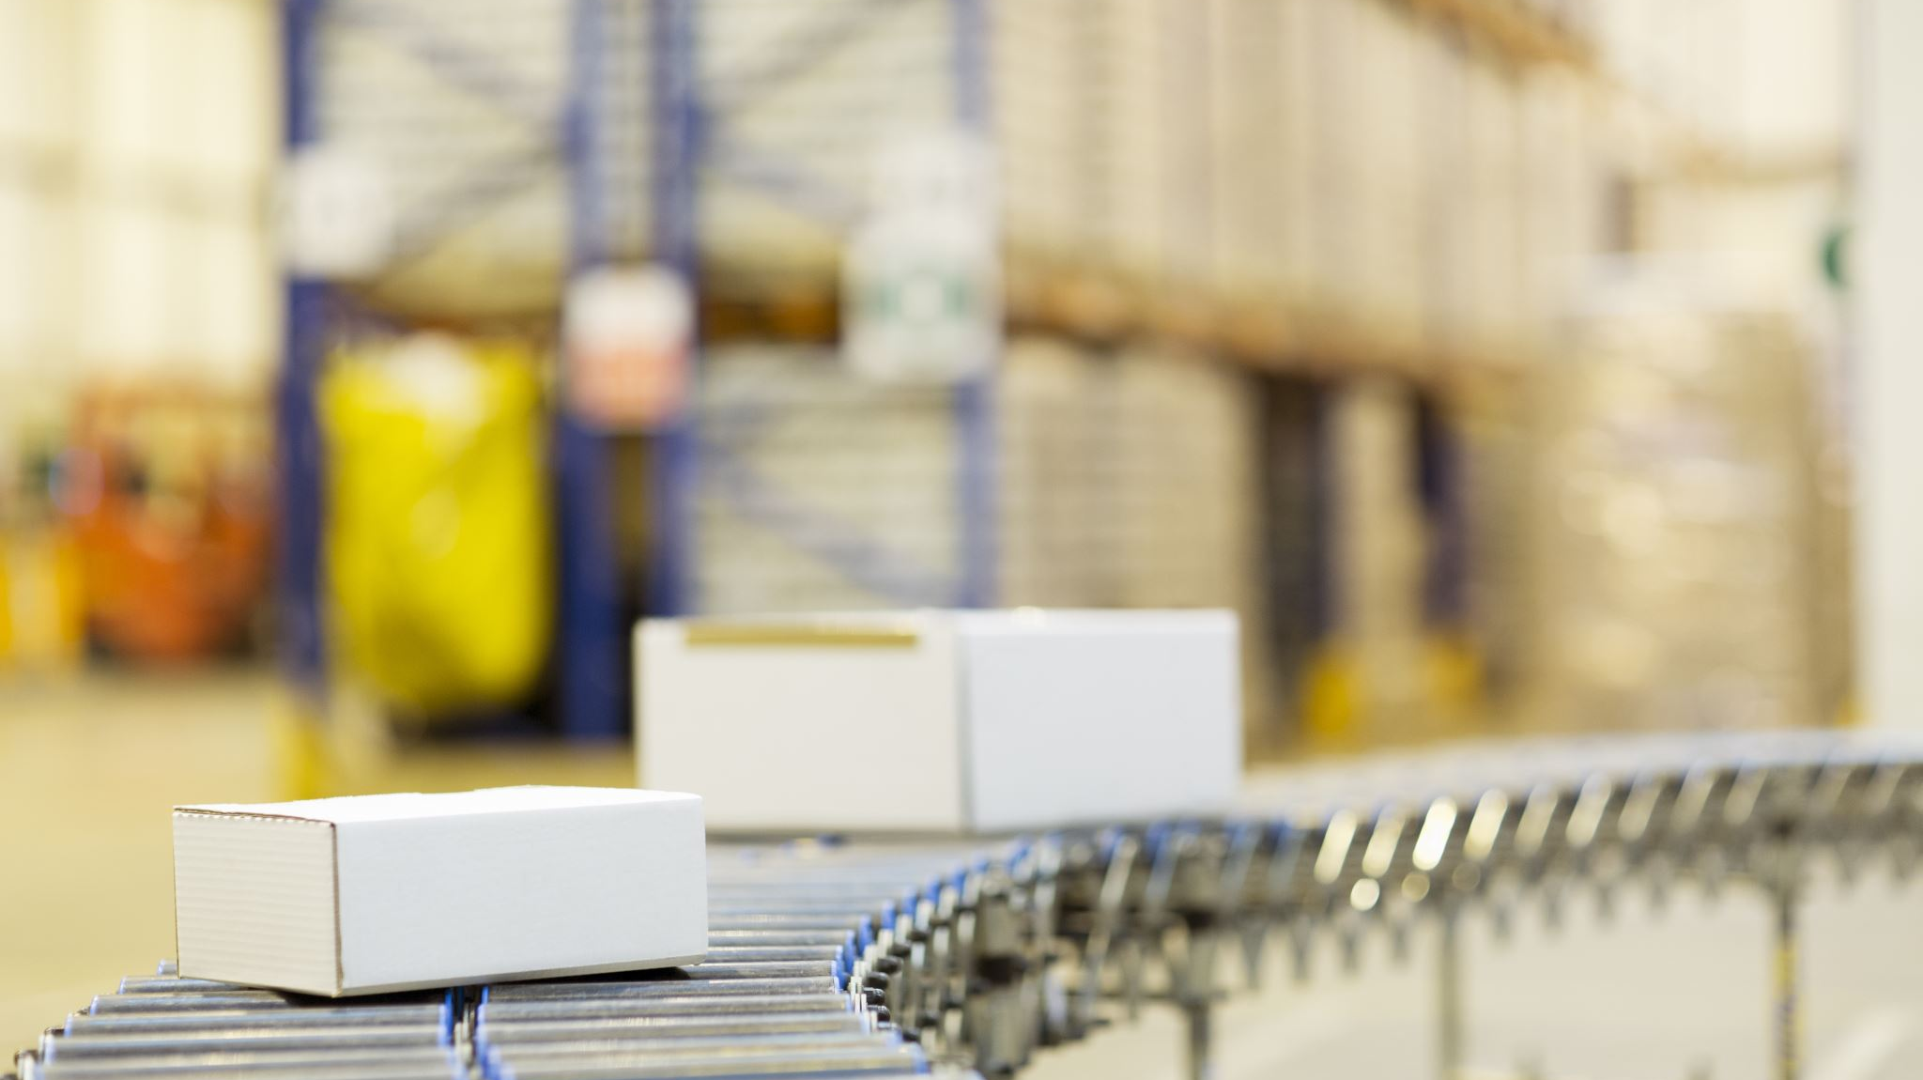
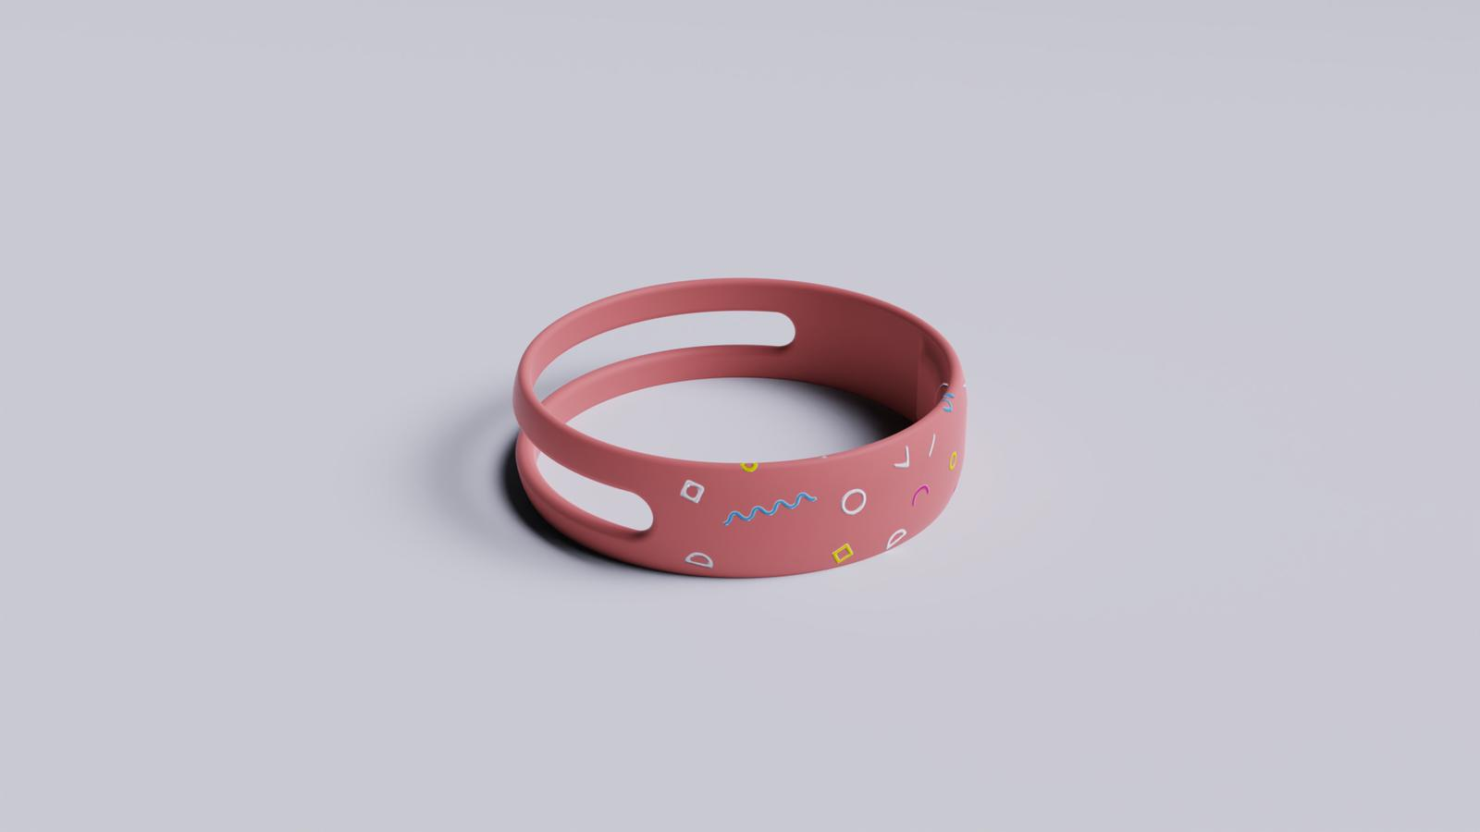
PRODUCT
Wrist band : LOOK-OVER
GPS
Temperature sensor
Wearable device with
Photoplethysmography (heartbeat sensor)
Motion sensor

Slide 6
IOT
sensor
Cloud
Notification to device

Slide 7
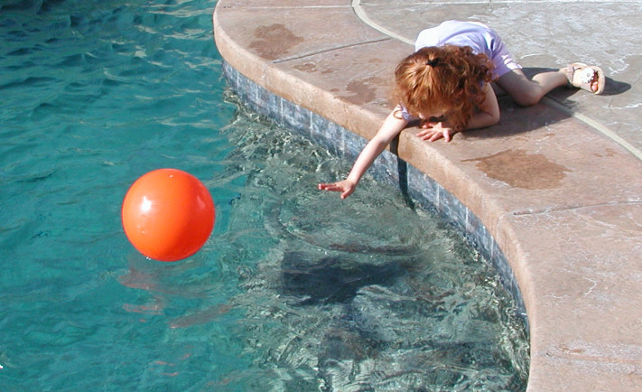
This Product notifies parents in following situation:
Fire ( sudden change in surrounding temperatures)
Sudden Change in heart rate
Sudden Change in body temperature
Sudden/Rapid body movements (fall, drowning)
This is how product works:
The parents will need to install the app and they”ll need toad the map of thee house in the app and need to mention the red areas in their house which means the areas that they consider could be dangerous for their child like swimming pool, stairs, fire place ,etc. The app will monitor all the data of the kid and store it to our database in our company’s server. Whenever there is sudden change in the data like heartbeats, temperature or body movements (via motion detectors); a notification will be sent to the parent via the app.

Slide 8

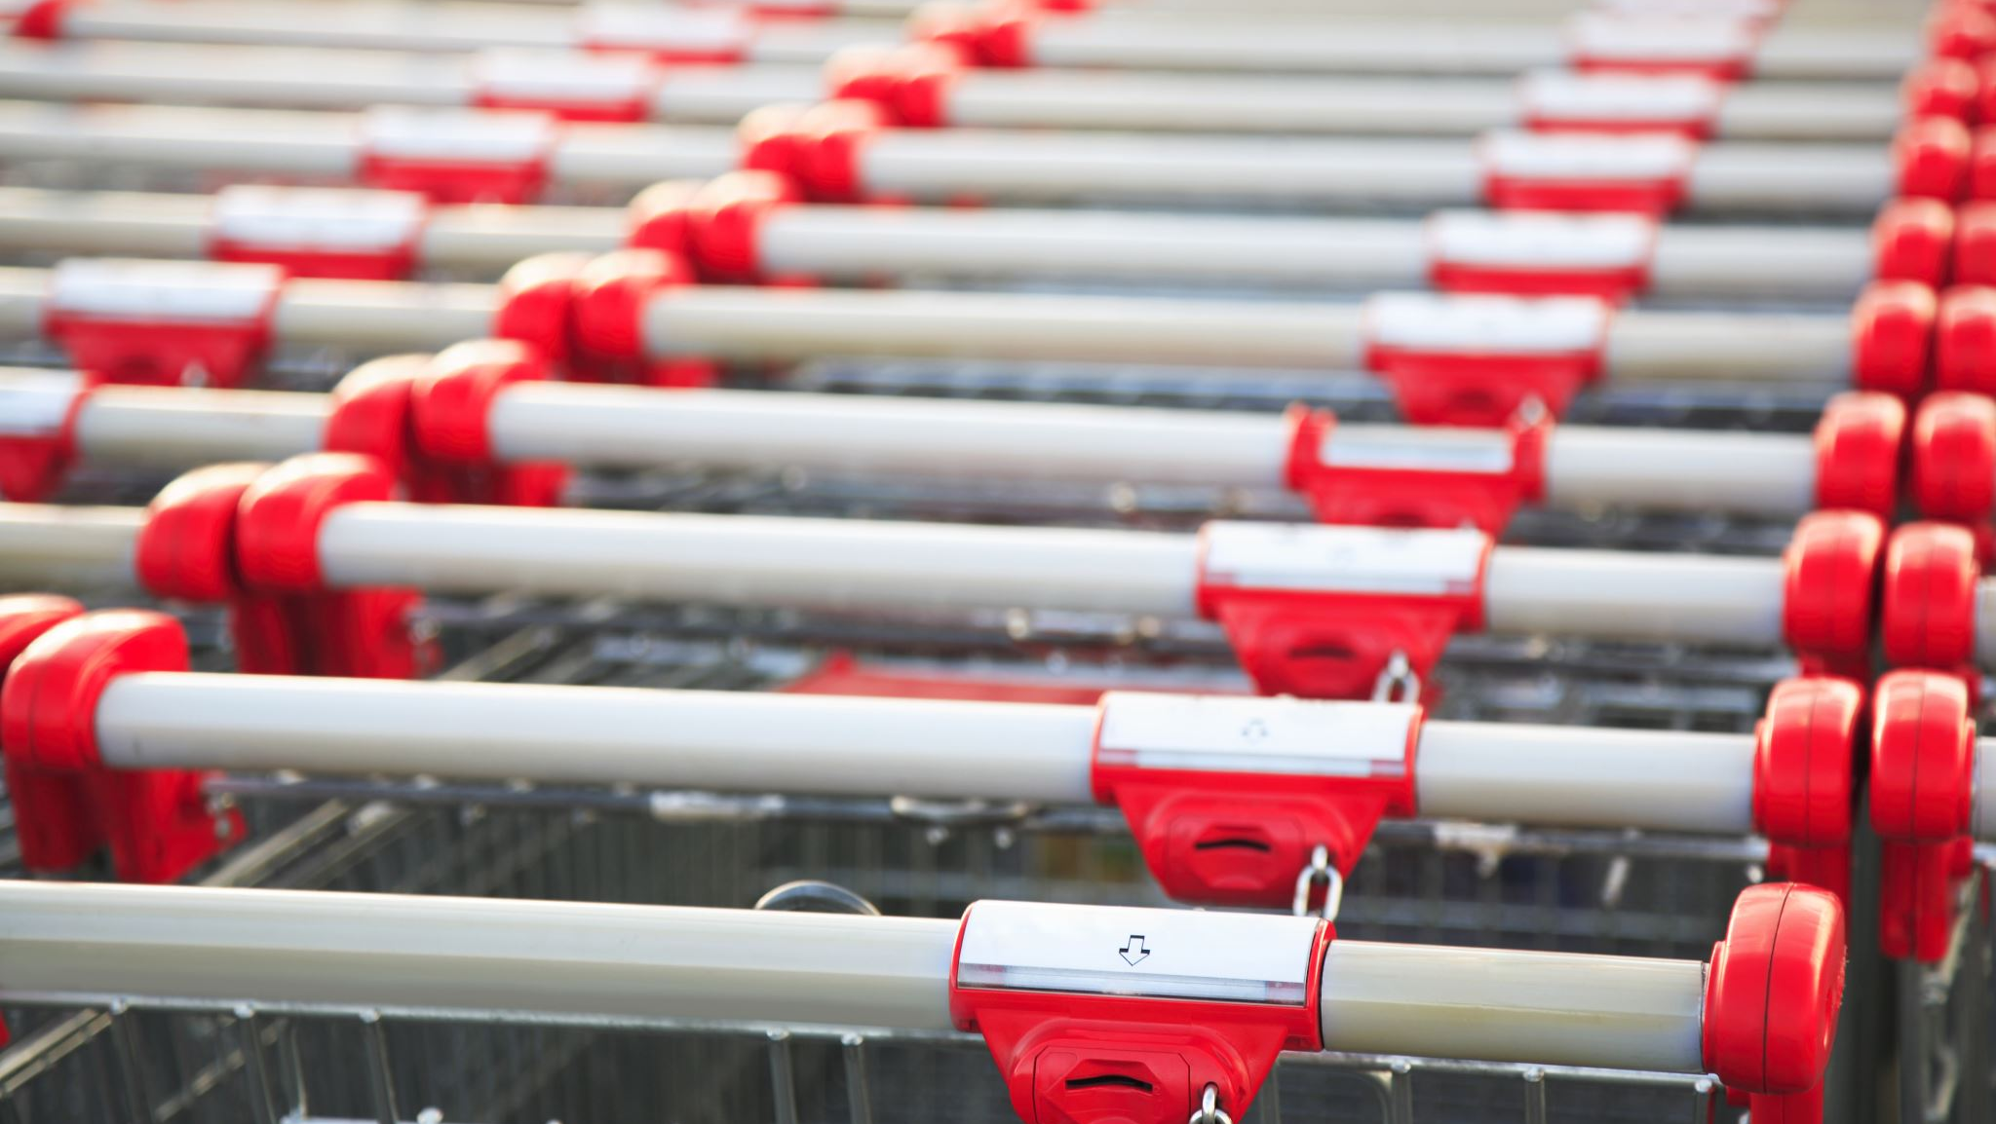
How we are different?
There are other similar products available in the market and quite not same what we are offering; All the other brands offer only one kind of feature but, none of them are offering all together.
Our product is much cheaper than all other brands.
No other product available in same segment.
Less complex as compared to others.
FDA approved.
Hypoallergenic Material.

Slide 9


Potential customers:
Working Parents
Single parents
Families that can’t afford babysitters and day cares.
Middle class and Upper-middle class families.

Slide 10

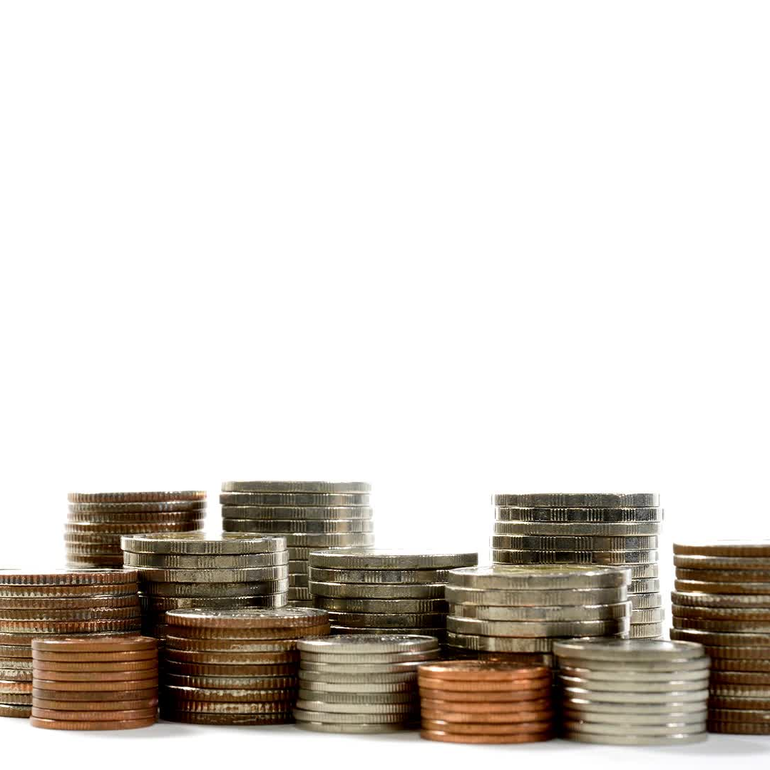
2000*24
3*60000*
$450000
$42000
Pricing
Cost of manufacturing is $50
Break-even point is $80.
Selling Price is $199.
How?
Total no. of kids : 1.2 Million
No. of kids to be targeted : 500,000
Estimated time period : 2 years
Total budget : $10 Million
Variable cost : $60

Slide 11
450000/500000
$60
$60.9
Breakeven Price =
Selling Price = 100
450000 / (100-60)
=
11250
Breakeven Quantity =

Slide 12

Revenue = 500000 * 100 = $50,000,000
Gross Profit = 19,550,000
Fixed Cost = $450000
Variable Cost = 500000 * 60 = 30,000,000

Slide 13
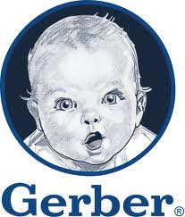
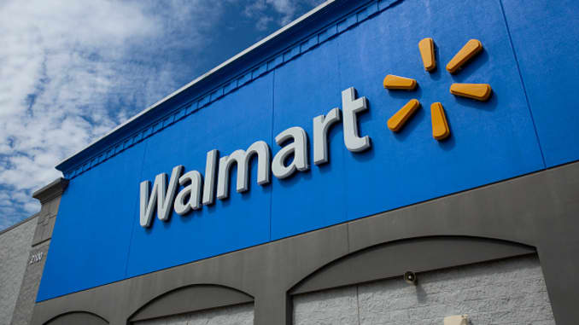

Promotion
Gerber
Promotional link redirecting customers to our websites
On-store ads
Ads in stores like Walmart, Costco and Target.
Social Media
You tube Kids, Instagram and Facebook

Slide 14
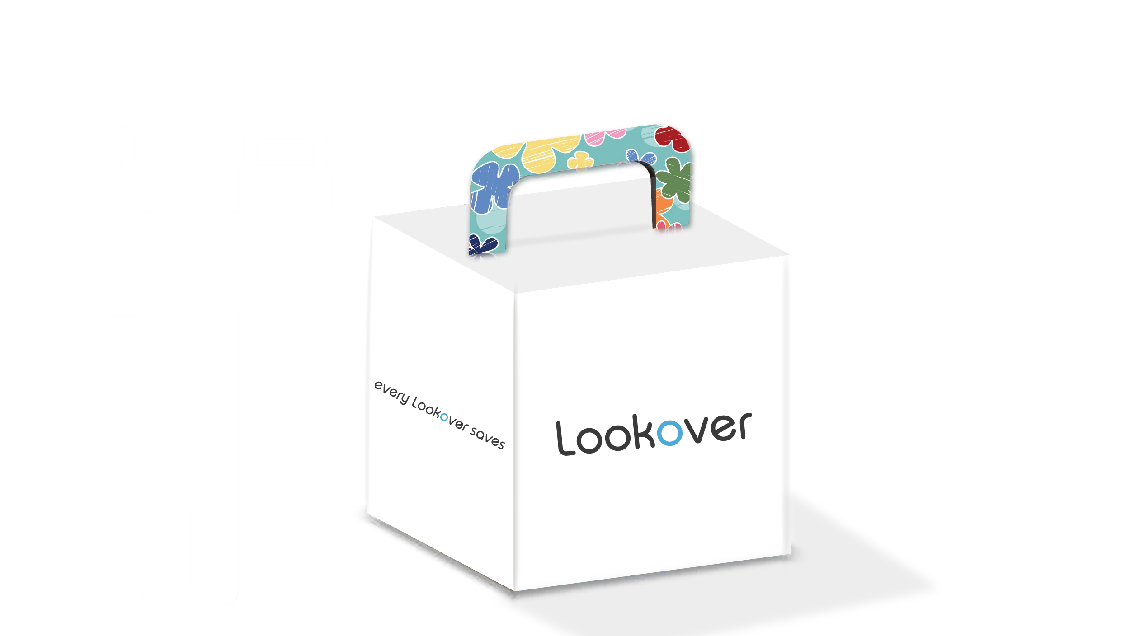
Packaging
Origami Box
Recyclable
Eco – Friendly
Frustration Free

Slide 15
SWOT
Strength
Weakness
Threat
Opportunities

Slide 16
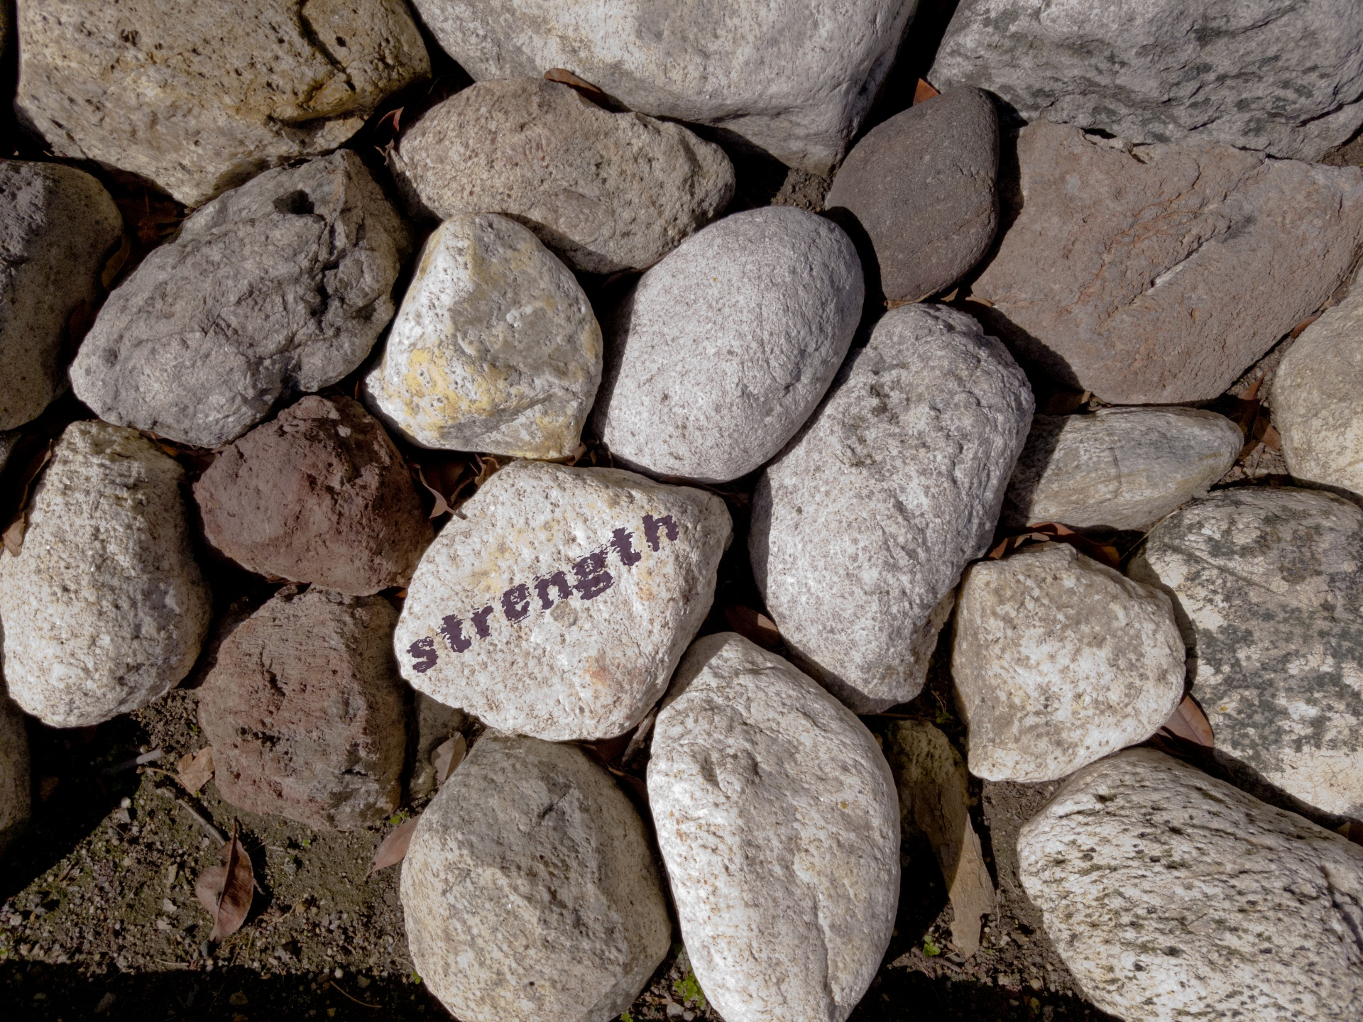
strengths
First Movers
Patent
Minimum Competition

Slide 17
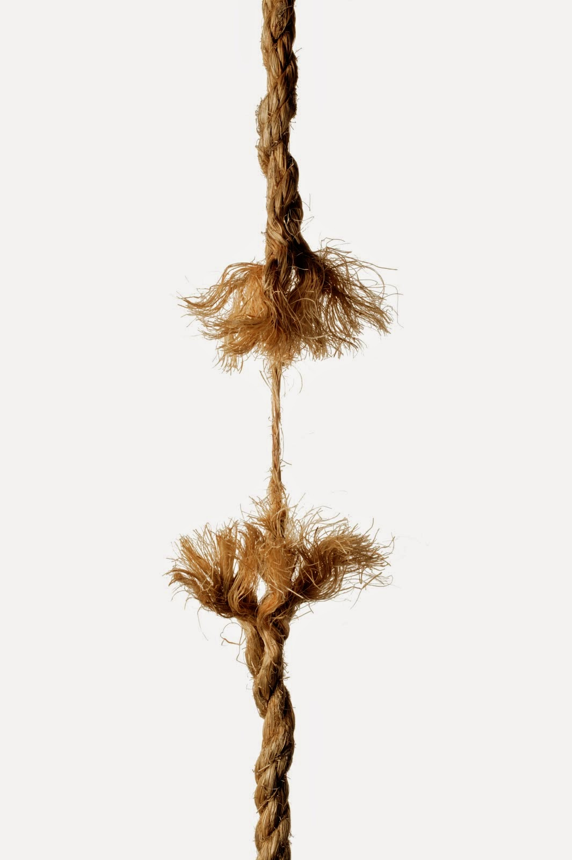
Weaknesses
Educational Disparity
Network issues
False Positive
(Failure in technology)

Slide 18

Threat
Babysitters
Upcoming Competition
Day care Centres

Slide 19

Opportunities
Overseas market
Outdoor Market
Tech upgrades

Slide 20
Future Growth Strategies
Create a medical alert wrist brand for the elderly people.
Expanding to European market and the entire country.
Product improvement:
*Removal sensor which notifies the parents if the watch is removed.
*Extended battery life of the product

Slide 21

Thank You
Any questions?

